Slide 1
2 0 1 7
Security Access Solutions

Slide 2
Audio Basics
SOUND LEVELS ARE IDENTIFID IN DECIBLES (dB)
SPL (SOUND PRESSURE LEVEL) THE AMOUNT OF AIR PRESSURE CREATED BY SOUND
AMBIENT NOISE IS THE DECIBLE LEVELS OF A ROOM OR AREA.
Examples:
Office = 65dB
Restaurant = 70dB
Train Platform = 90dB
Construction Site = 95dB
ISC Trade Show Floor = 94dB

Slide 3
Audio Basics cont.
“CONVENTIONAL” AUDI0 VOICE MESSAGES ARE CONSIDERED TO BE AUDIBLE WHEN THE MESSAGE IS 10 TO 15 DECIBLES ABOVE THE AMBIENT NOISE LEVEL.
WHEN THE POWER OUTPUT IS DOUBLED, YOU GAIN 6 DECIBLES IN OUTPUT ENERGY
If a 30W TO A SPEAKER = 100 DECIBLES
60W TO A SPEAKER = 106 DECIBLES
INVERSE SQUARE LAW – EVERY TIME YOU DOUBLE THE DISTANCE FROM A SOUND SOURCE YOU LOSE 6dB.

Slide 4
60W HORN
1M
2M
4M
8M
16M
18M
32M
130dB
124dB
118dB
112dB
106dB
100dB
Based on the above example, in a high noise environment of 95dB (CONSTRUCTION site), the Horn is only affective up to 16 M as the sound produced by the horn needs to be 10 TO 15 dB above the AMBIENT noise level.
In the above example, the assumptions are ONLY valid if there are no other environmental factors limiting audibility such as Wind, Humidity and physical obstructions.
The example does not indicate the “Harshness” of the horn, especially within the first 1-8 meters.

Slide 5
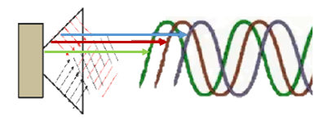
CONVENTIONAL SPEAKERS –“Cone”
Conventional speakers and horns use a cone shape to project sound toward its intended target. When sound is generated from a conical device, multiple signal waves are generated from reflection and multiple phase emission which results in distortion. The farther the sound travels, the more distortion occurs, resulting in a less intelligible message over long distances.
Notes:
Think of this as a standard Flash Light, cone shape projector. The “light” disperses quickly. Though the light close up “seems” bright, it quickly dissipates’ Its hard to see anything past 20 feet or so.

Slide 6
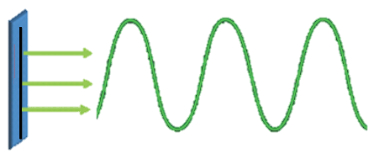
Clear Voice Technology - Planar
Magnetic Audio Device (MAD) uses Planar Technology to generate the audio signal. The Clear Voice “transducer” generates a single, perfectly shaped sound wave that can travel long distances while delivering superior intelligibility. The advanced technology also provides the ability to generate an intelligible signal at a volume level that is 10dB lower than the ambient noise level of the operating environment, reducing the risk of hearing damage to the operator and those in close proximity.
Notes:
Planar only sends “1” sound wave through a “Flat” surface. There are no self destructive “collisions” and therefore able to travel farther distances with clarity. Since it only produces “1” sound wave, the wave is “Stronger”, does not collide with itself and has less tendency to “disperse”

Slide 7
The Difference
Security Access Solutions

Slide 8
60W HORN Vs. Clear Voice “1MN” (powered hand held)
1M
2M
4M
8M
16M
32M
130dB
124dB
118dB
112dB
106dB
100dB
114dB
111dB
108dB
105dB
102dB
99dB
A CLEAR VOICE 1MN (Hand Held) speaker with a maximum output of 114dB at 1 meter will dramatically outperform a conventional Horn 60W with130 dB in similar environments
At 16 meters the Horn’s output is 106dB, 1MN is at 102dB both speakers can heard.
At 32 meters the Horn is at 100dB, CLEAR VOICE is at 99dB, both speakers can be heard.

Slide 9
Comparison within construction Zone - 95 dB Ambient Noise
1M
2M
4M
8M
16M
32M
130dB
124dB
118dB
112dB
106dB
100dB
114dB
111dB
108dB
105dB
102dB
99dB
Messages can be heard:
Horn 10-15 dB above Ambient Noise
1MN -10 dB of Ambient Noise
At 16 meters the Horn’s output is 106dB so “audibility” within the 95 dB Ambient Noise is “barley acceptable”. Since the 1MN sound operates at -10 dB, the 1MN can be heard much “Clearer”, even at 32 meters.

Slide 10
Clear Voice Advantages
“INTELLIGIBLE” MESSAGES ARE DELIVERED AT 10 DECIBLES BELOW THE AMBIENT NOISE LEVEL.
WHEN THE DISTANCE FROM THE SPEAKER IS DOUBLED, THE DECIBLE LOSS WITH A CLEAR VOICE SPEAKER IS ONLY 3 DECIBLES
CLEAR VOICE TECHNOLOGY ALLOWS YOU TO USE FEWER DEVICES TO COVER A BIGGER/LOUDER AREA
CLEAR VOICE SIGNAL CHARACTERISTICS ALLOWS A DESIGN TO HAVE CROSSING SOUND WAVES WITHOUT CREATING DISTORTION OR SIGNAL CANCELLATION. CANNOT DO THIS WITH CONVENTIONAL SPEAKERS

Slide 11
CLEAR VOICE Music Sound Systems
PLANAR MUSIC SPEAKERS
CLEAR – CLEAN
CRISP
UNMATCHED CLARITY AND PERFORMANCE
“HEARING IS BELIEVING”

Slide 12
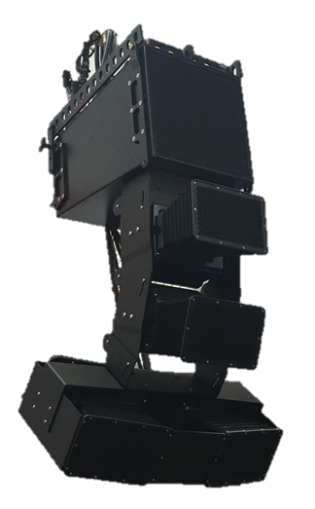
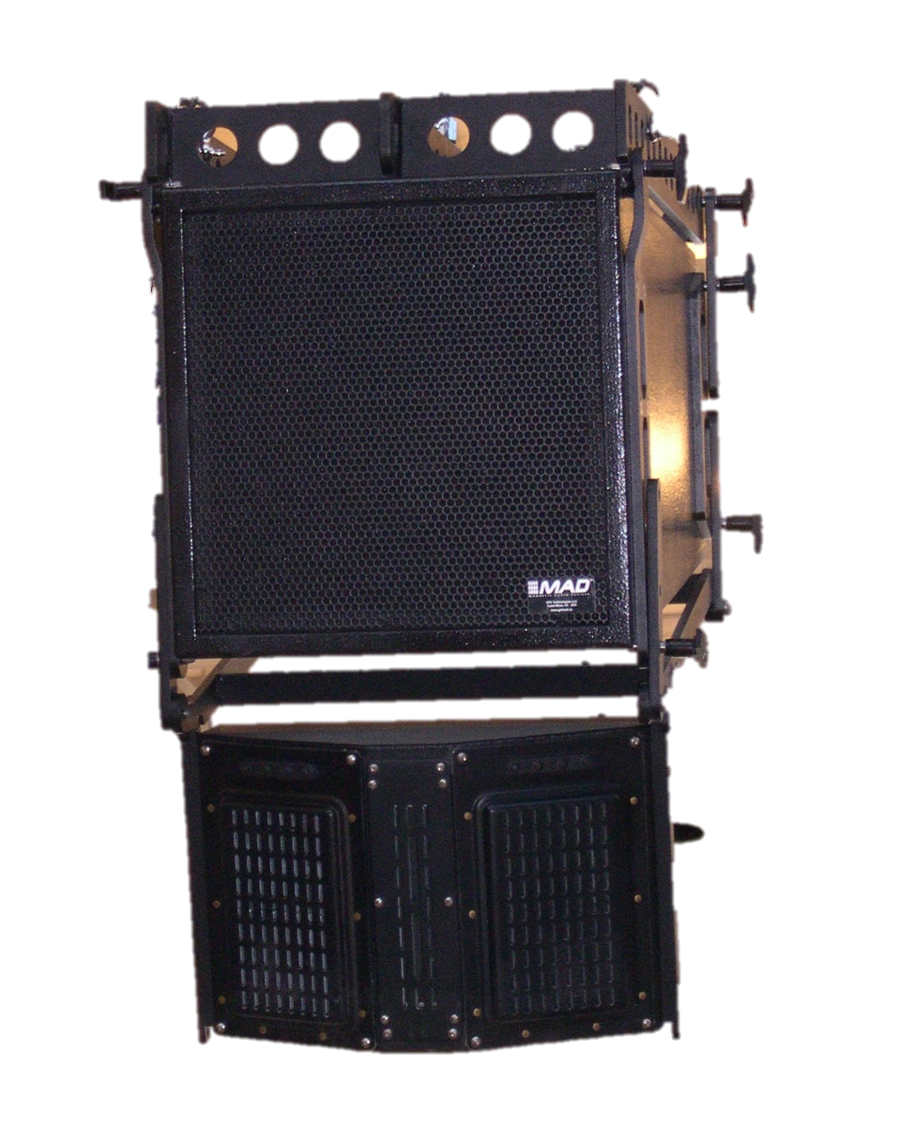
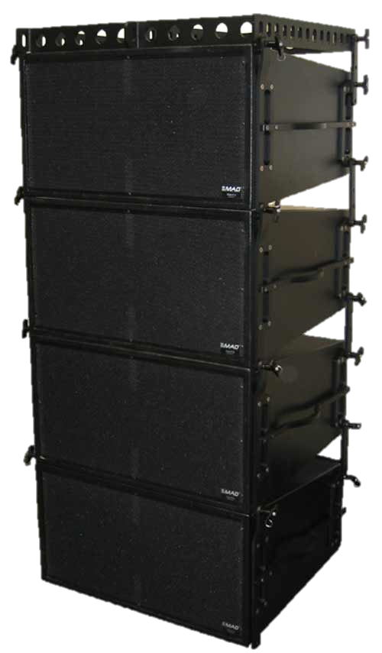
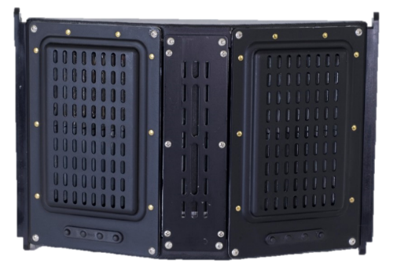
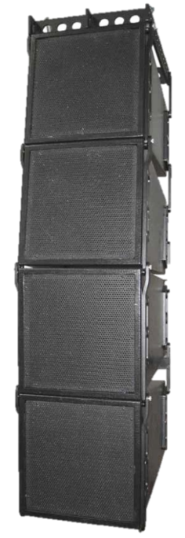
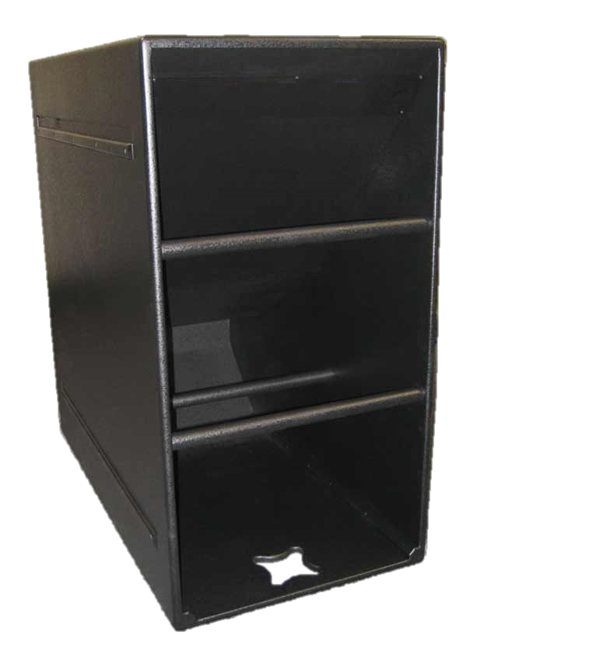
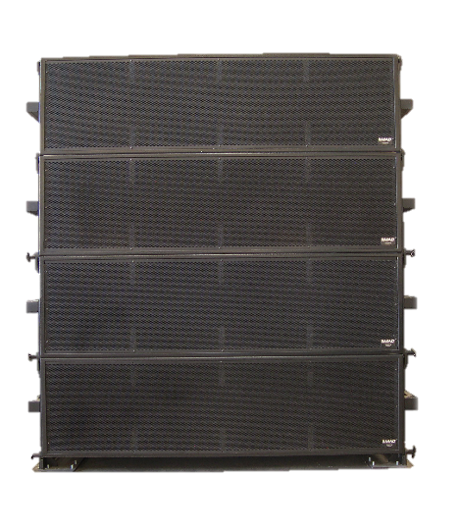
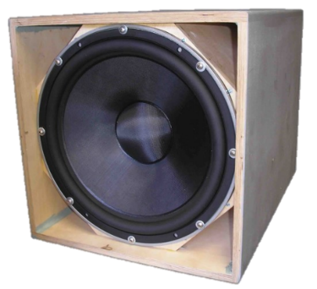
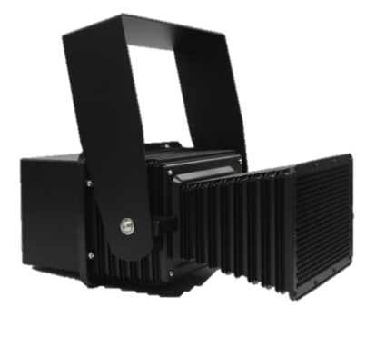
CLEAR VOICE – MUSIC CABINETS
MTM-1/SB112C
MTM-1
SB112C ARRAY
VFL
SB212C ARRAY
SB112C/1MN RIG
VFL JR.
1-MN-P
SB412C ARRAY

Slide 13
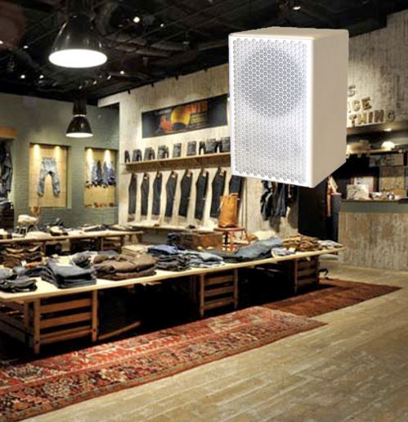
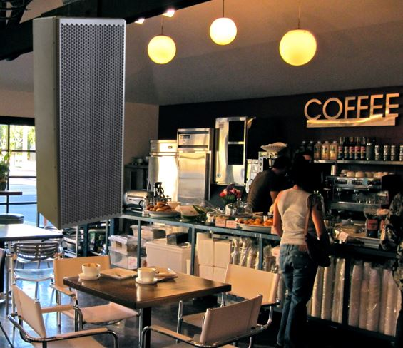
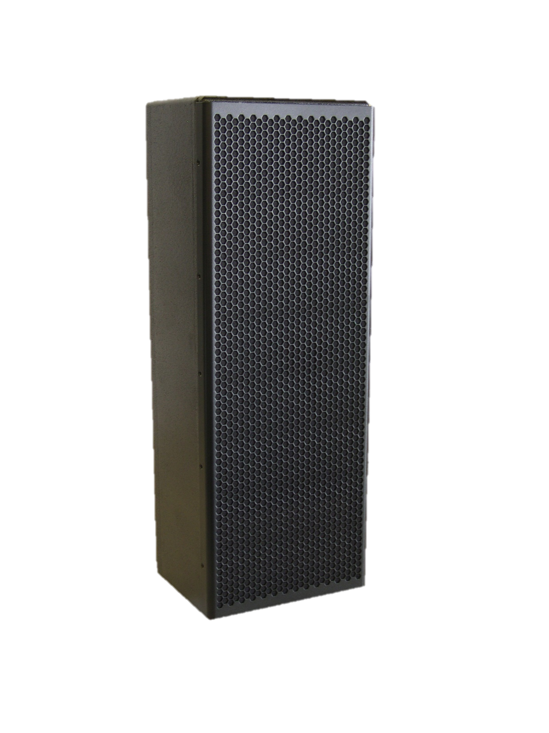
CLEAR VOICE SMALL FORMAT SPEAKERS
MPS-3
MPS-2

Slide 14
CLEAR VOICE – MUSIC CUSTOMERS
CONVENTION HALLS
HOUSE OF WORSHIP
THEATERS
CONCERT HALLS
WAREHOUSES
NIGHT CLUBS
CASINO THEATERS
RETAIL STORES
SHOOL CAMPUS
PARKING LOTS
CRUISE SHIPS
TOURING COMPANIES
STAGE AND LIGHTING COMPANIES
CONFERENCE HALL
SHOPPING MALLS
COFFEE SHOPS

Slide 15
Delivering audio excellence to thousands… Times Square - New York City
“Broadway on Broadway”
Notes:
The Music was provided through 2 sets of arrays, each with 16 speakers for a total of only 32 speakers

Slide 16
Over 300,000 listeners heard this concert! Broadway - New York City
Notes:
It only took 2 speaker arrays of 24 speakers each to accomplish this!

Slide 17
…outdoors concerts… U.S. Capital – Washington D.C.

Slide 18
…outdoors concerts… Cologne, Germany

Slide 19
…winter sports festivals… Flachau, Austria

Slide 20
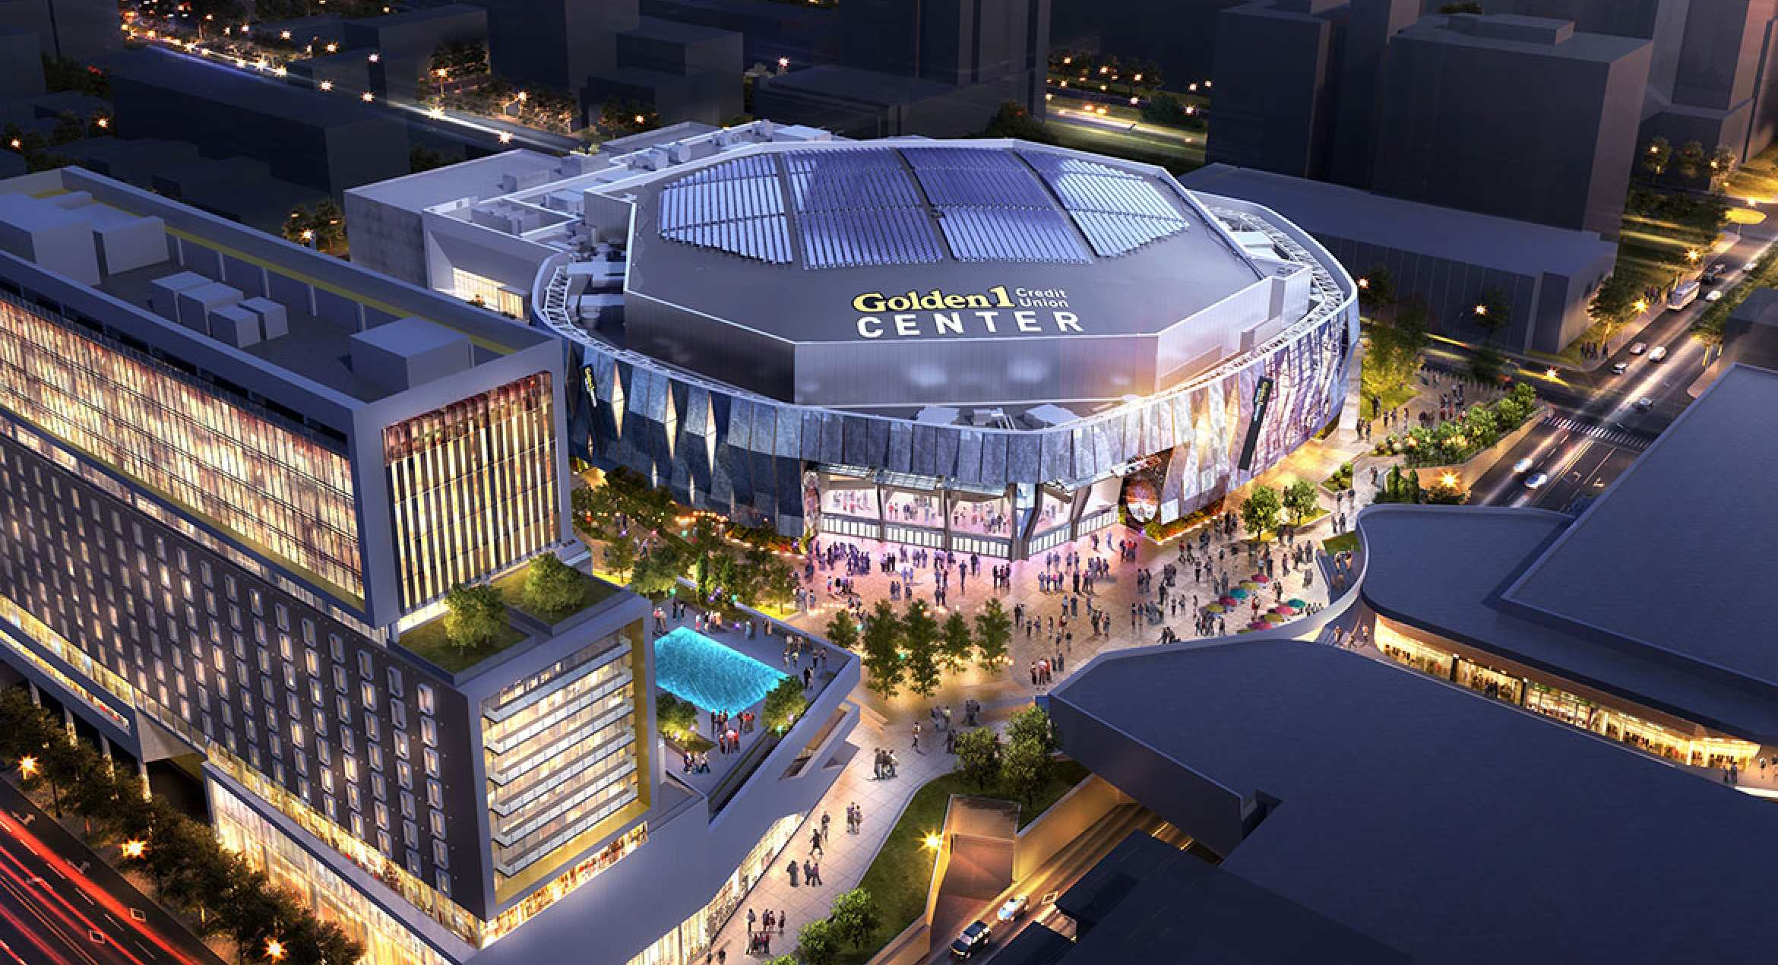
…indoor arenas… Sacramento Kings, California

Slide 21
…sports stadiums… Kedah, Malaysia

Slide 22
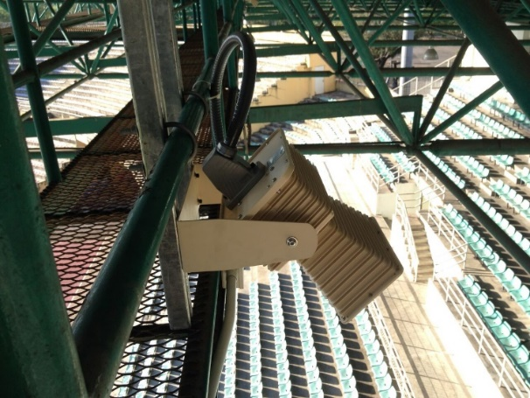
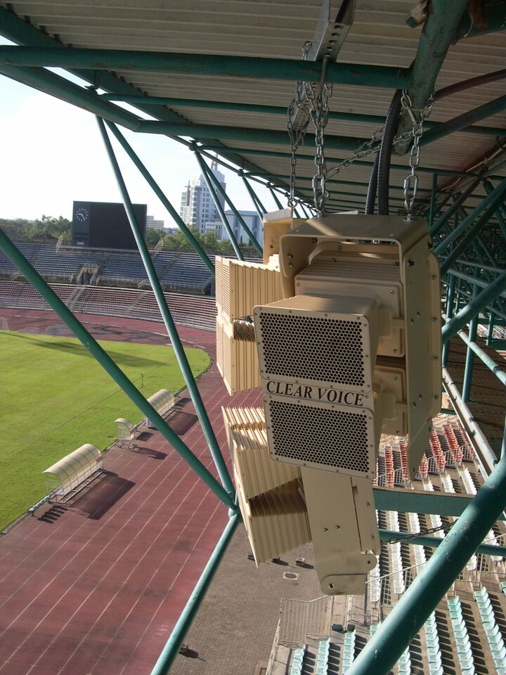
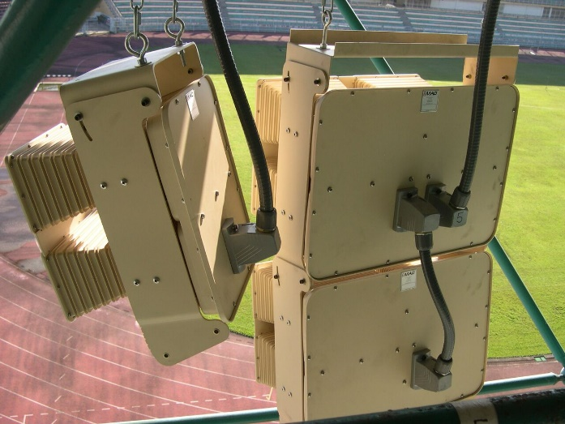
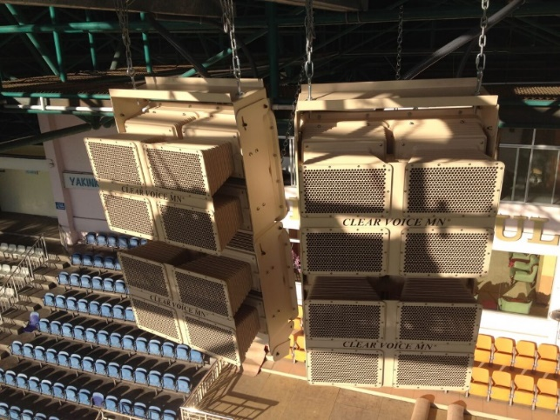
…sports stadiums… Kedah, Malaysia

Slide 23
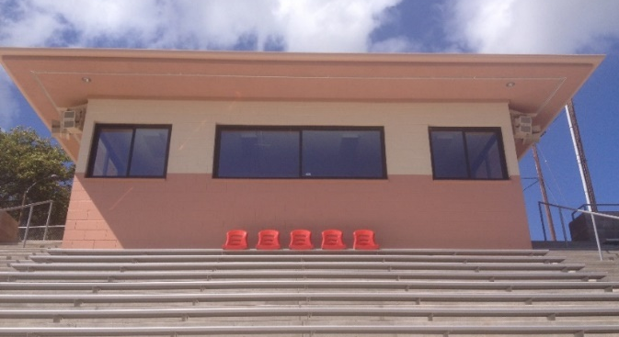
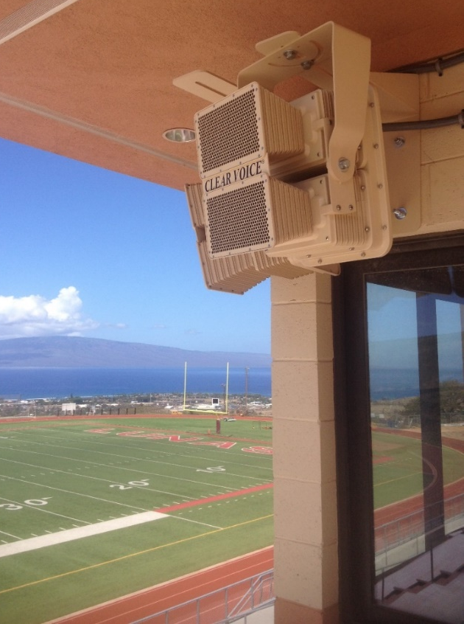
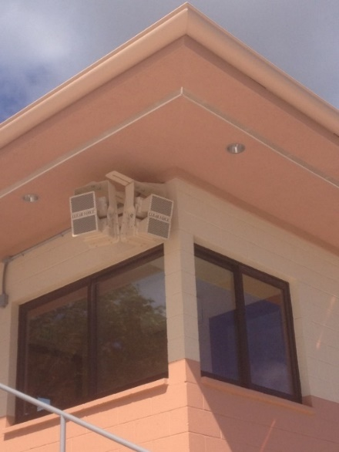
…sports stadiums… Maui Hawaii

Slide 24
…churches of every size… 5,000 seats – Memphis, Tennessee

Slide 25
…churches of every size… 2,800 seats - Indianapolis, Indiana

Slide 26
…churches of every size… 1,000 seats - Denver, Colorado

Slide 27
…churches of every size… 700 seats - Maui, Hawaii

Slide 28
…churches of every size… 400 seats – Highlands Ranch, Colorado

Slide 29
Innovators in Security Access Systems Design

Slide 30
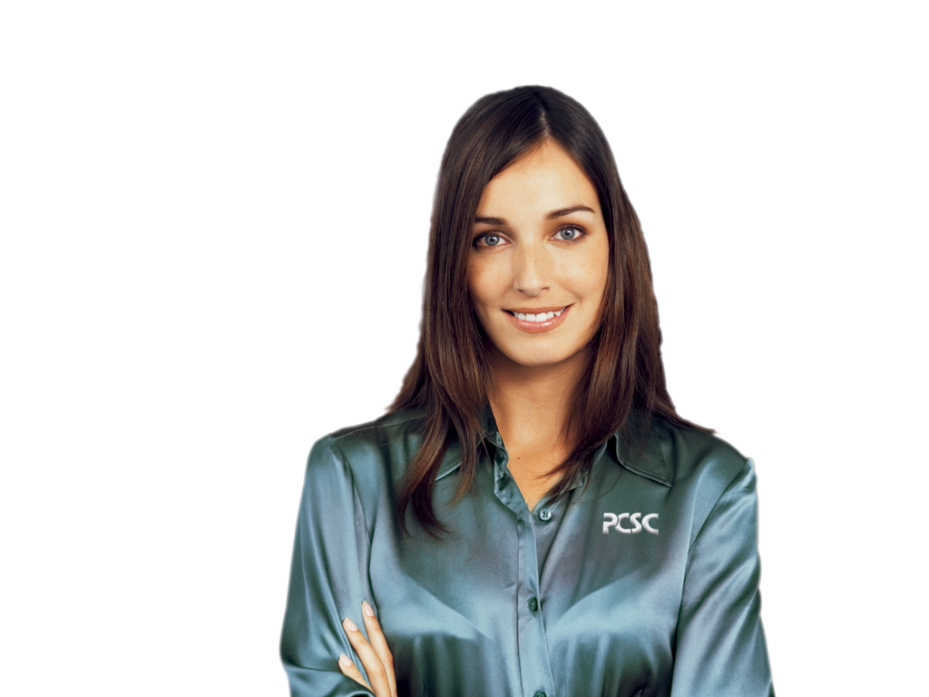
Any Questions?
Clear Voice Sound Systems utilizing
Magnetic Audio Technology

Slide 31
Industry Strong for Over 3 Decades
1 9 8 3
2 0 1 7
Security Access Solutions

